Slide 1
CS218- Data Structures
Week # 01
Lecture – 01
Mubashra Fayyaz

Slide 2
Agenda
Introduction to Course & Conduct
Description
Grading Scheme
Textbook
Assignments
Quizzes
Course Outline

Slide 3
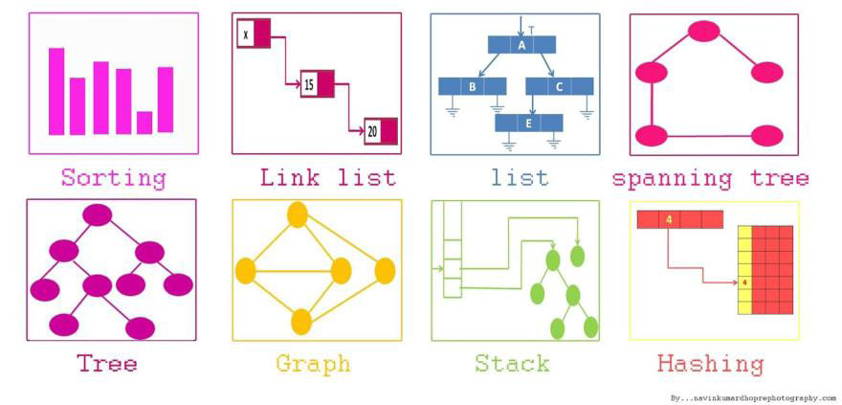

Slide 4
Course Description
Data Structures is a core course in Computer Science curriculum.
It is an essential building block for solving applied problems with computers.
The course will introduce the fundamentals of data structures and will provide thorough understanding of how to systematically organize data inside a computer system.

Slide 5
Basic Introduction
What is data structure?
Data structure provides the special format in order to store data in a organized way.
E.g. of Data structures: Arrays, Linked list, Tree, etc.
Why we use data structure?
Data structures helps us to access, storage and process data in memory with efficient way.

Slide 6
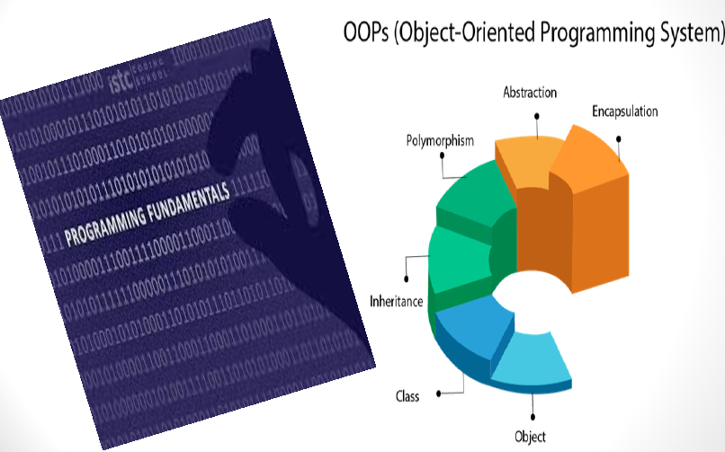
Course Pre-requisites

Slide 7
Course Description
The course discusses basic memory management for efficiently solving problems on both time and space requirements.
A variety of data structures will be discussed theoretically, their efficient implementations and application cases will also be discussed.
The student will learn abstraction, encapsulation and structures for efficiently processing information in a variety of scenarios.

Slide 8
Grading Scheme
■ Programming Assignments | 15%
■ Quizzes | 05%
■ Midterm Exam | 20%
■ Class Project | 10%
■ Final Exam | 50%

Slide 9
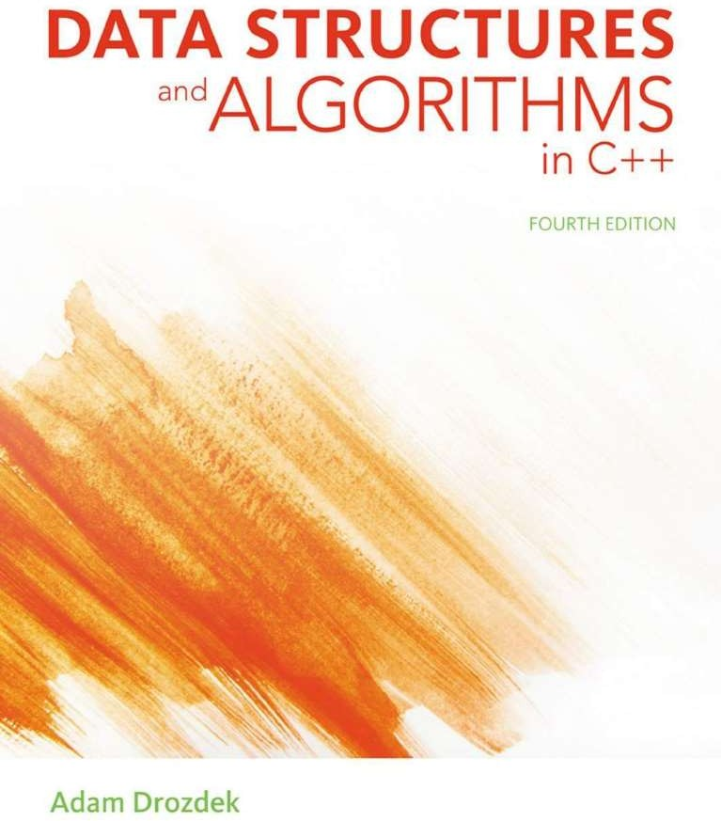
Textbook & References
Leading Text in CS
■ Strengthen your understanding of data structures and their algorithms for the foundation you need to successfully design, implement and maintain virtually any software system

Slide 10
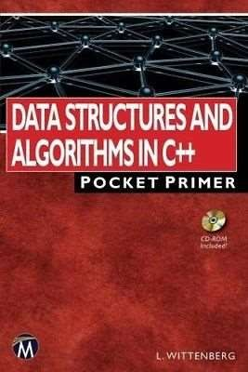
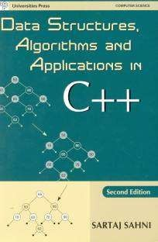
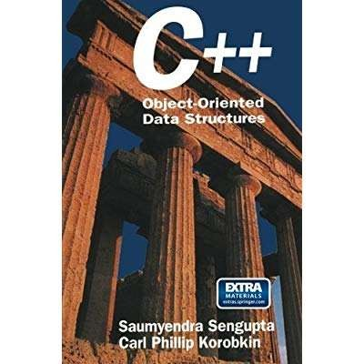
Some Good References

Slide 11
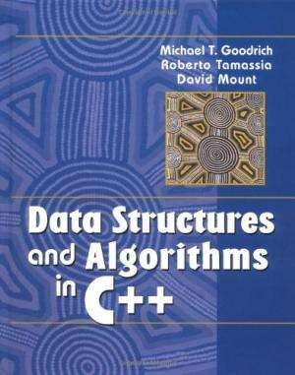
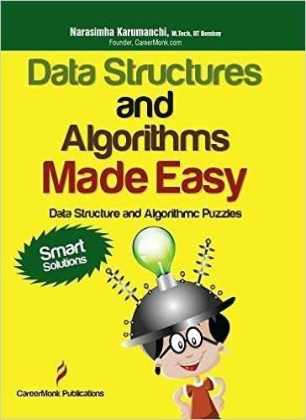
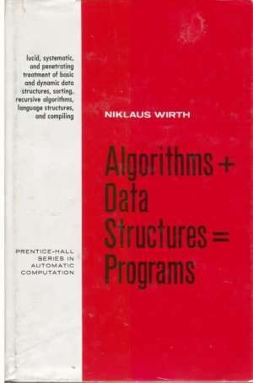
Some Good References

Slide 12
Programming Assignments
There will be 3 programming assignments, each assignment may contains 2-4 problems.
These programming assignments will be on provided with sample input/output test cases.
The assignments are for individual, plagiarism will not be tolerated.
You need to access the platform with your nu mail IDs.
There may be more hidden test-cases for the problems.

Slide 13
Programming Assignments
Deadline and Penalty
Deadline is mentioned for each Programming Assignment (Usually 2 weeks time)
After the deadline – there will be a penalty of 25% if the assignment submitted after first 48 hours, for each 48 hours it reduced to 25% hence there will be no marks after 8 days.
Marks are only given if the submission passed plagiarism check and manual check.
Plagiarism cases may be awarded an F grade.

Slide 14
Quizzes
There will be 4-5 quizzes – all surprise quizzes
Best n-1 will be counted
Weightage 05 %

Slide 15
Midterm Exam
Two midterm exams – one hour each as per policy.
Weight 10 % each

Slide 16
Final Exam
There will be a 3 hours exam as per policy.
Weightage 50%

Slide 17
Class Participation
Very important instrument for creating an impact.
I appreciate questioning…
There will be no marks for it but make sure everyone participate

Slide 18
Class Projects
There will be a class project -You can have 2- 3 members- members allow within sections.
Weightage 10%
The “Theme” for CS201- Data Structures class project is “Data Structures for Large Datasets”
We will have 3-4 meeting during the course for the class projects.
Class project call and schedule will be announced on slate later.

Slide 19
Class Projects
Call for class project
You need to submit a proposal mentioning team members name, project title and a brief description about the project. ( 1 mark for each submitted proposal)
Class Project Demos – 2 marks
Code review – 2 marks
Idea and completion – 4 marks
Project report – 1 mark

Slide 20
Weekly Plan
Session | Topics | Chapters
1 | Course Overview, Introduction to Course & Conduct, Grading Scheme, Text Book, Quizzes, Assignments
2 | C++ Language Specification & OOP | Chapter 1
3 | C++ Language Specification & OOP
4 | Recursion - 1 | Chapter 5
5 | Recursion - 2
6 | Recursion - 3
7 | C++ Dynamic Memory Management
8 | Arrays (1D) – Dynamic Safe Arrays
9 | Arrays (2D)
10 | Different Type of Arrays
11 | Node and List (Singly Linked List) | Chapter 3
12 | Some utility functions of List (Singly Linked List)
13 | List (Circular Linked List)
14 | List (Doubly Linked List)
15 | Elementary Sorting Techniques -1 | Chapter 9
16 | Midterm I – Exam

Slide 21
Weekly Plan
17 | Elementary Sorting Techniques -2 | Chapter 9
18 | Advanced Sorting
19 | Searching
20 | Stack -1 | Chapter 4
21 | Stack - 2
22 | Stack – application
23 | Queues + Priority Queues
24 | Queue Application
25 | Heap
26 | Trees – BT, BST, MWT-- 1 | Chapter 6-7
27 | Trees – BT, BST, MWT-- 2
28 | Trees – BT, BST, MWT-- 3
29 | Trees – BT, BST, MWT-- 4
30 | Hashing - 1 | Chapter 10
31 | Hashing - 2
32 | Graphs - 1 | Chapter 8
33 | Graphs Traversals- 1
34 | Graphs Traversals- 2
35 | Weighted Graphs
36 | Graph Algorithms

Slide 22
Consultancy Hours
Consultancy Hours:
Monday 10-12
Tuesday 9- 12
Wednesday 9-12
Contact me
email: mubashra<dot>fayyaz@nu<dot>edu<dot>pk
Google Classroom
Section 3D: zvj5xx4
Section 3F: ygbsw2v

Slide 23
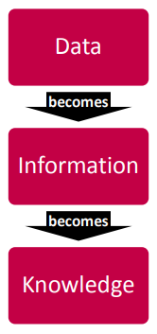
Data vs. Information vs. Knowledge
The concept of data as it is used in the syllabus is commonly referred to as ‘raw’ data – a collection of text, numbers and symbols with no meaning. Data therefore has to be processed, or provided with a context, before it can have meaning.
Example
3, 6, 9, 12
cat, dog, gerbil, rabbit, cockatoo
161.2, 175.3, 166.4, 164.7, 169.3

Slide 24
Data vs. Information vs. Knowledge
Interplay with data in context
If we put Information into an equation it would look like this:
Data + Meaning = Information
Example
3, 6, 9 and 12 are the first four answers in the 3 x table
cat, dog, gerbil, rabbit, cockatoo is a list of household pets
161.2, 175.3, 166.4, 164.7, 169.3 are the heights of 15-year-old students.

Slide 25
Data vs. Information vs. Knowledge
acquiring and remembering a set of facts, or
the use of information to solve problems.
If we put knowledge into an equation it would look like this:
Information + application = Knowledge
Example
4, 8, 12 and 16 are the first four answers in the 4 x table (because the 3 x table starts at three and goes up in threes the 4 x table must start at four and go up in fours)
The tallest student is 175.3cm.
A lion is not a household pet as it is not in the list and it lives in the wild.

Slide 26
Data Structures:
Logical and formal abstract way to represent and store data in such a way that it will quickly available for processing within the application context.
It is an organized collection of data which perform a set of operations effectively on the data. These set of operations are formally related to an idea of specific processing related to problem solving.

Slide 27
Algorithm:
An algorithm is a fancy to-do list for a computer. Algorithms take in zero or more inputs and give back one or more outputs.
You explicitly need to tell a computer to perform each step that eventually transform some input into a desire output. It should be finite set of instruction.

Slide 28
Algorithm+ Data Structures = Program
Data structures and algorithm are integral parts of problem solving through computer.
Half of the problem is selecting the right data structures and half of the problem is to select the algorithm.

Slide 29
Human Vs. Computer
Storage
Time
Accuracy
Work process
Decision
Orders
Feelings

